Slide 1
Ads Click Through Rate Prediction using Python
AMAN KHARWAL
13 June 2024

Slide 2
Agenda
Ads Click-Through Rate
The dataset
Analysis
Prediction model
Final notes - Improvements

Slide 3

Ads Click-Through Rate Prediction
Ads Click Through Rate is the ratio of how many users clicked on your ad to how many users viewed your ad.
Notes:
Analyzing the click-through rate help companies in finding the best ad for their target audience.
This analysis will take you through Ads Click Through Rate prediction with Machine Learning.

Slide 4
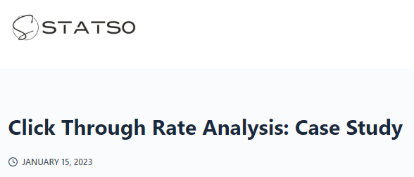
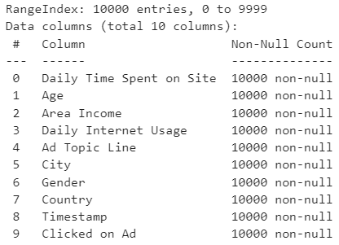

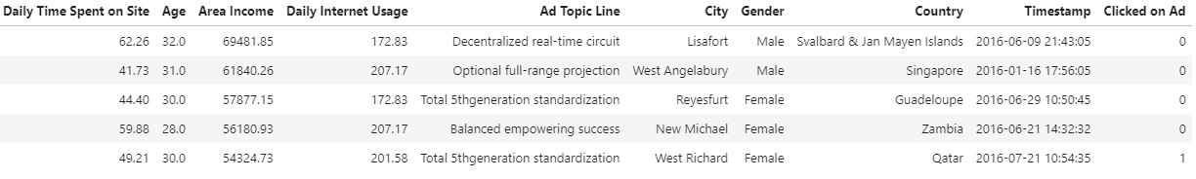
The Dataset
https://statso.io/click-through-rate-analysis-case-study/
https://www.kaggle.com/gauravduttakiit
Notes:
Where is found. Publicly available
10k entries

Slide 5
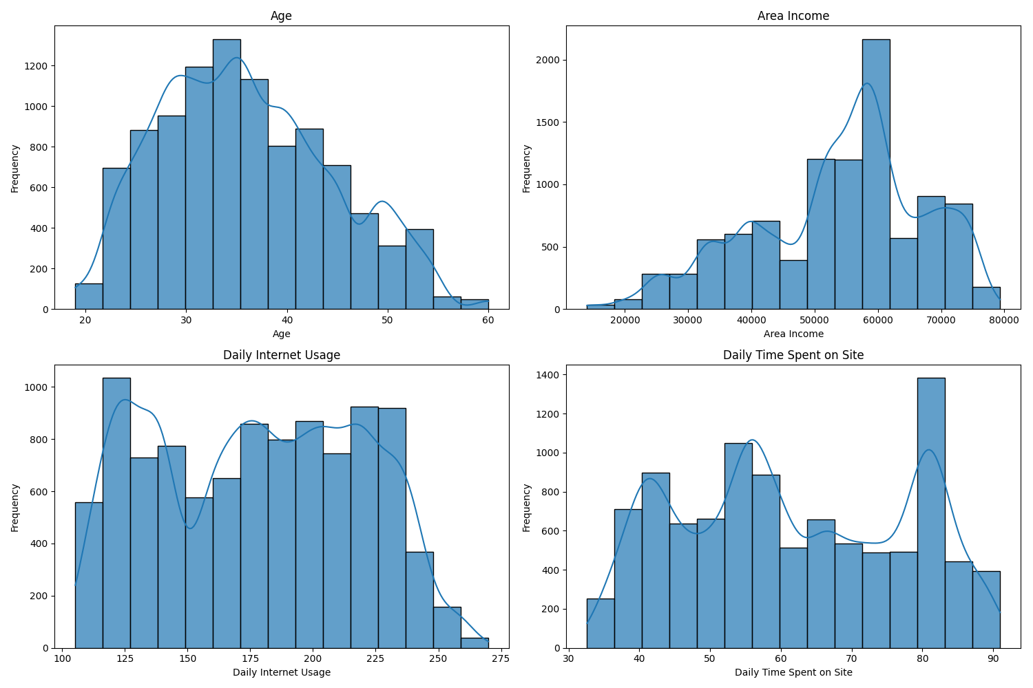
Distribution of the dataset
Age [25-40]
Income [50k-60k]
Time usage: Homogeneous dispersion

Slide 6
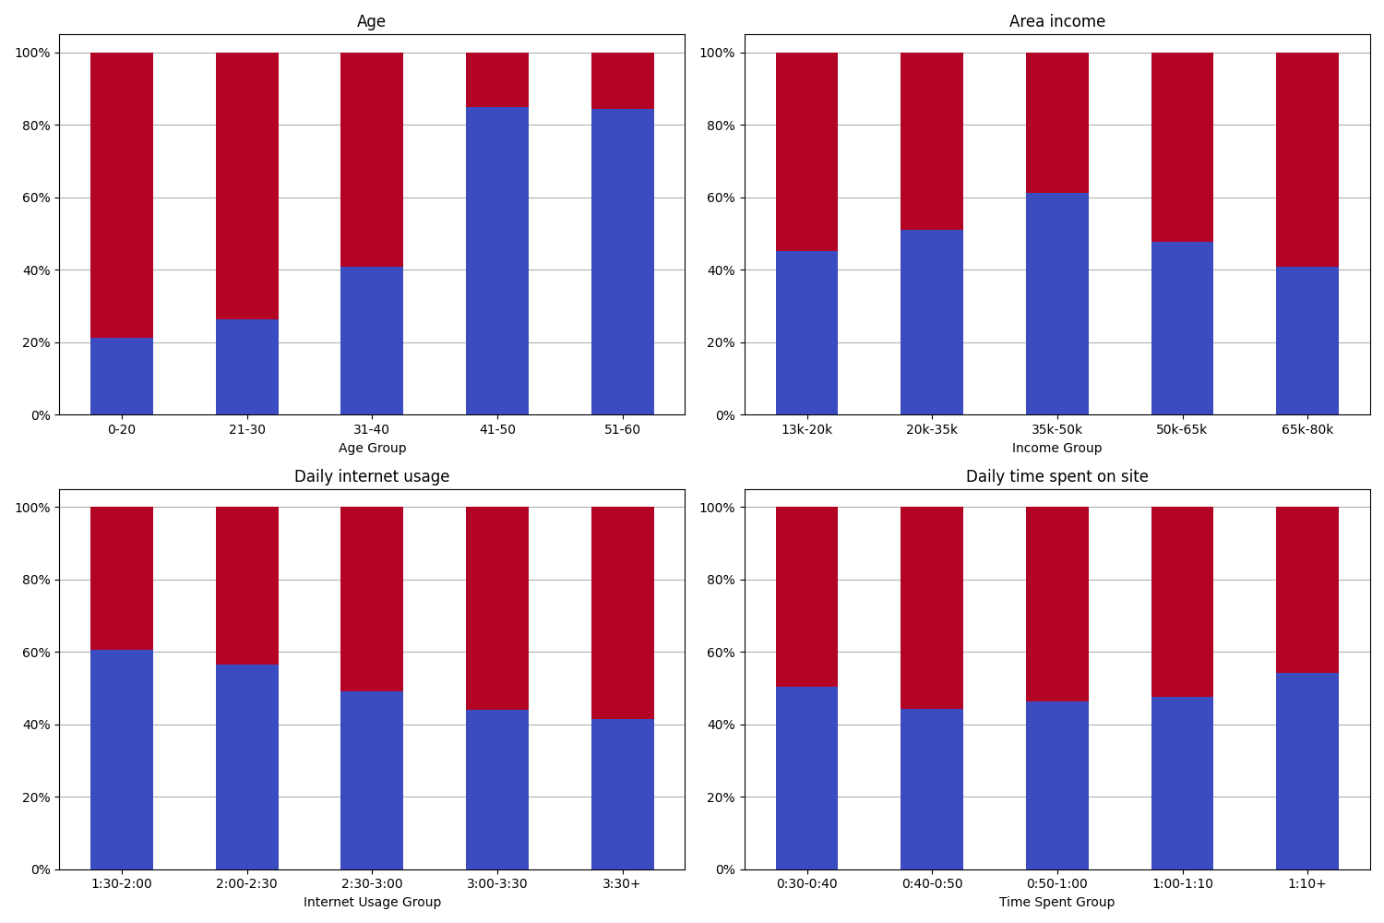
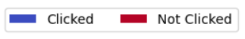
Notes:
Normalized stacked bar chart

Slide 7
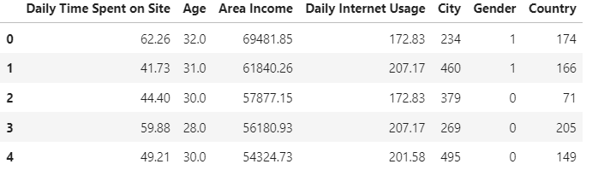
Prediction Model
In the dataset 5 columns are preprocessed:
Gender: binary mapping.
Country, City: label encoding, one integer number for each of them.
Ad Topic Line: we omit it to keep it simple.
Timestamp: not relevant in this scenario.
We end up with the following training dataset:

Slide 8
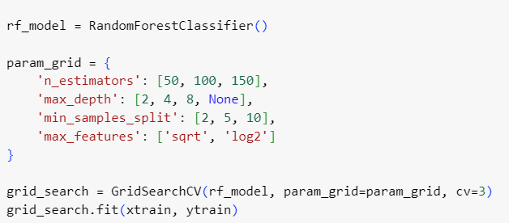
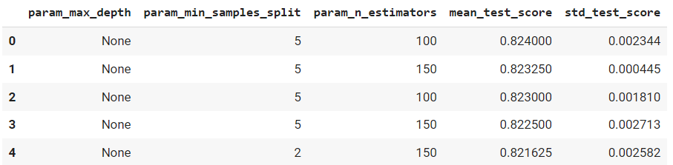
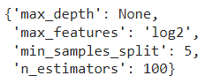
Hyperparameter tuning
Grid Search
Fits the model with all combinations of parameters specified.
Used in all the models that have been tried.
Random search was also tried but led to poor results.
Feasible in this case due to simplicity.
Notes:
Example: Random Forest
Selected Parameters & Cross validation
Executions & score
Best Parameters

Slide 9
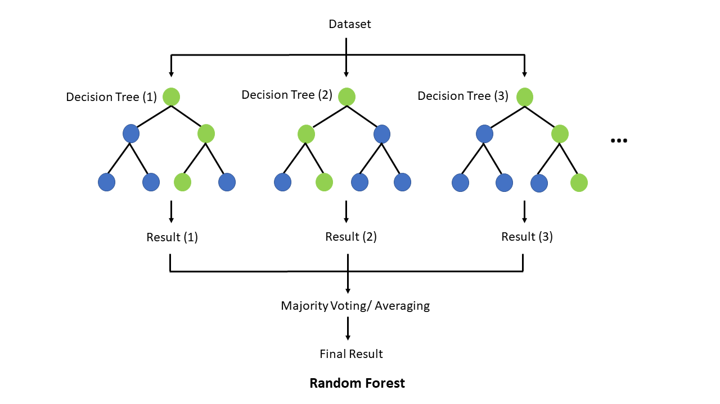
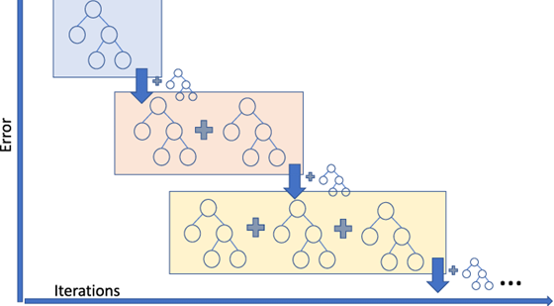
Ensemble models based on decision trees
Random forest
XGBoost
Builds multiple independent decision trees and outputs the majority vote.
Bagging and random subset of features selected.
Averaging predictions and randomness prevent overfitting.
Applicable to a wide range of domains, more interpretable.
Builds trees sequentially, each new one correcting errors made the previous one.
Gradient boosting algorithm to minimize the loss iteratively.
Built-in L2 and L1 regularization reduce overfitting.
Winning algorithm in Kaggle competitions.

Slide 10
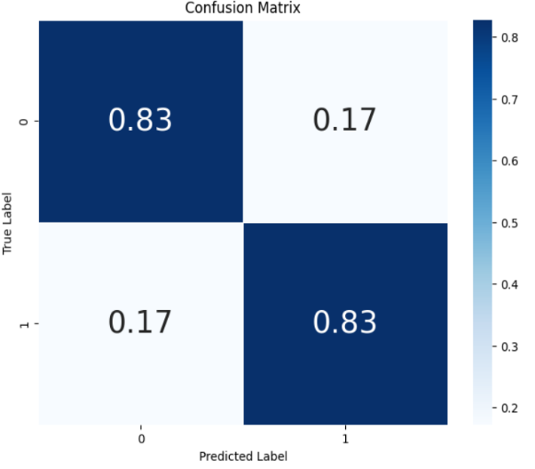
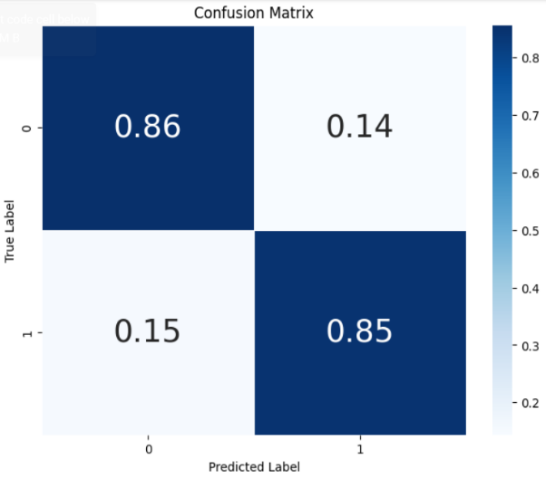
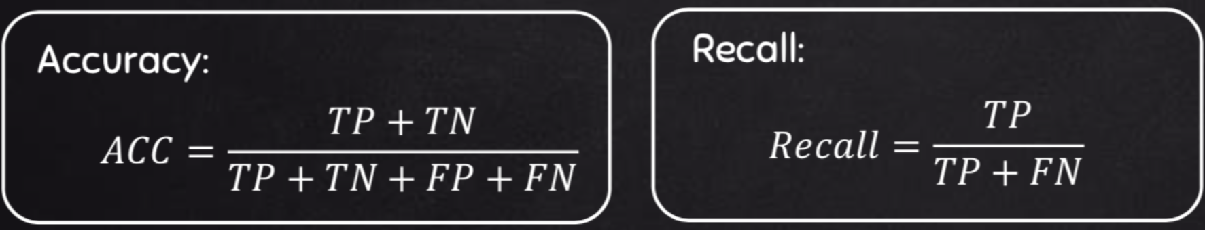
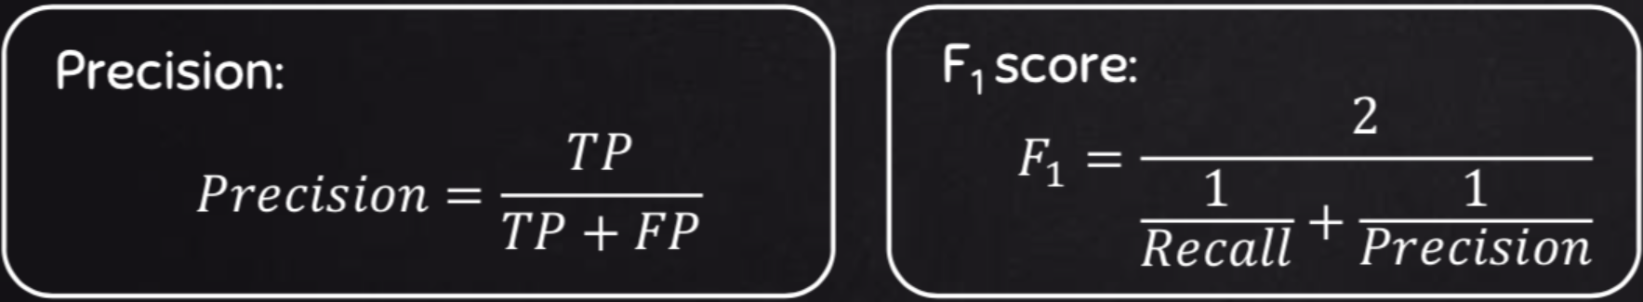
Results
Random forest
XGBoost
Recall: 0.8297
Precision: 0.8101
Accuracy: 0.8265
F1-Score: 0.8197
Recall: 0.8475
Precision: 0.8422
Accuracy: 0.8520
F1-Score: 0.8449

Slide 11
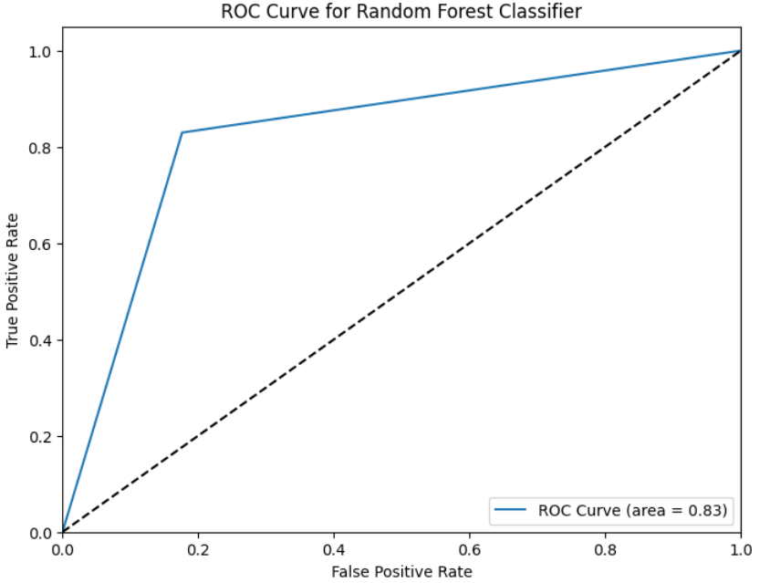
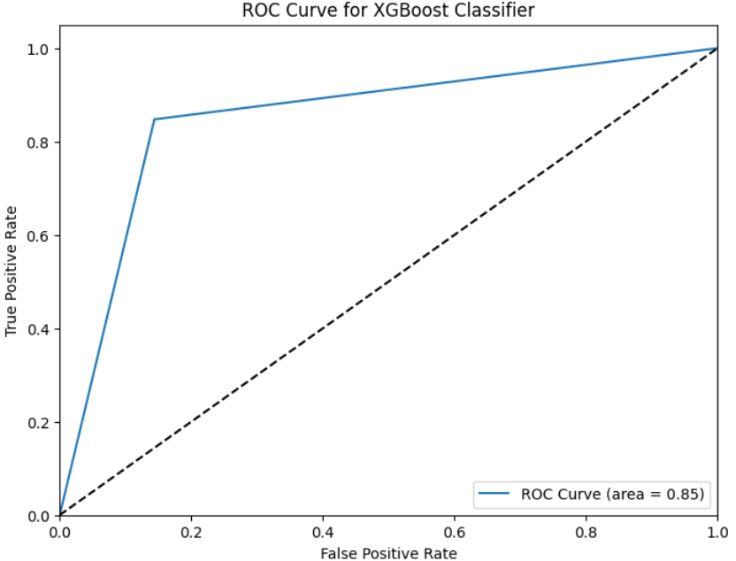
Results
Random forest
XGBoost

Slide 12
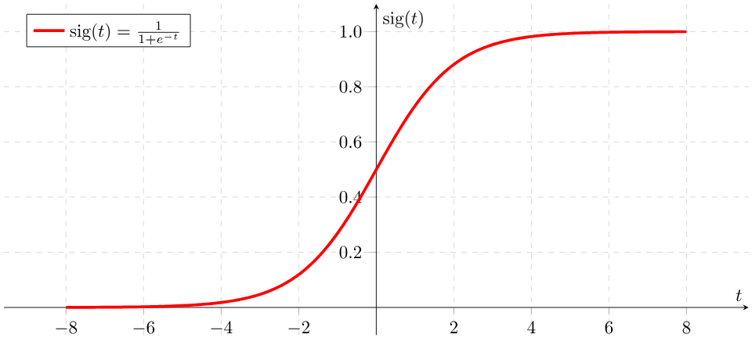
Logistic Regression
White-box, interpretable model
It uses a sigmoid (logistic) function to map any real value in the range 0 to 1, which represents the probability that an instance belongs to the positive class.
Uses the log-loss function to measure the discrepancy between model predictions and actual labels.
Lower accuracy around 0.70 with no tuning

Slide 13
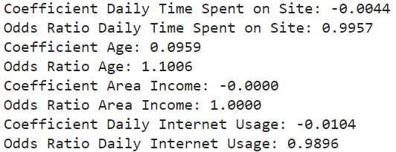
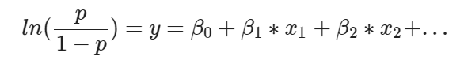
Coefficients interpretation:

Slide 14

Conclusions
Data & Analysis:
Good dataset.
Charts could be improved.
Model & Predictions:
Data preprocessing techniques and feature selection.
Model selection and hyperparameter tuning.
Interpretability?
Notes:
Ads CTR prediction problem is really useful
Influencing factors + Click prediction → More revenue

Slide 15
Sources
All images have Creative Commons licenses, were made by AI or come from plots of this study.
https://commons.wikimedia.org/wiki/File:Sigmoid-function-2.svg
https://medium.com/analytics-vidhya/what-is-gradient-boosting-how-is-it-different-from-ada-boost-296f055ecacd
https://commons.wikimedia.org/wiki/File:Random_forest_explain.png
https://www.kdnuggets.com/2020/04/performance-evaluation-metrics-classification.html
https://www.thebluediamondgallery.com/handwriting/c/conclusions.html

Slide 16
Thank you
Alberto Ruiz Alejandro
Jesús Ramos Rodríguez

